Slide 1

Interest & Dividends
4491-08-B Income - Interest and Dividends v11.0 VO.pptx
Pub 17, Chapter 7 & 8
Pub 4012, Tab D and Tab 2

Slide 2
Taxable Interest Income
Income from banks and credit unions, CDs or bonds
  Interest income is unearned income (money, not TP, is earning the income)
Report interest in year earned or, in case of bond purchased at discount, increase in value is taxable in year of increase
Make all interest entries on TaxWise “Interest Statement of Schedule B”

Slide 3
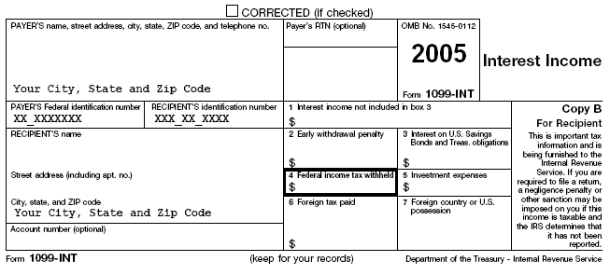
1099-INT
2008

Slide 4
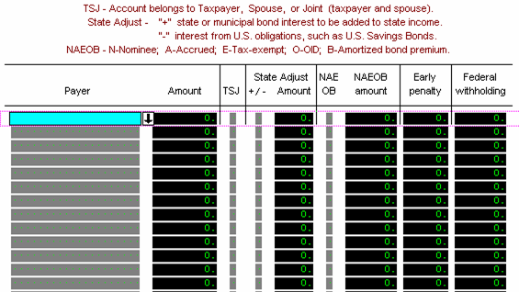
Interest Statement
Flows to 1040 Line 8a & 8b
1099 - INT
$$$$
1099 - OID
$$$$
SPLIT INCOME – MFJ vs MFS
Flows through Schedule B, Part 1 – if OVER $1,500

Slide 5
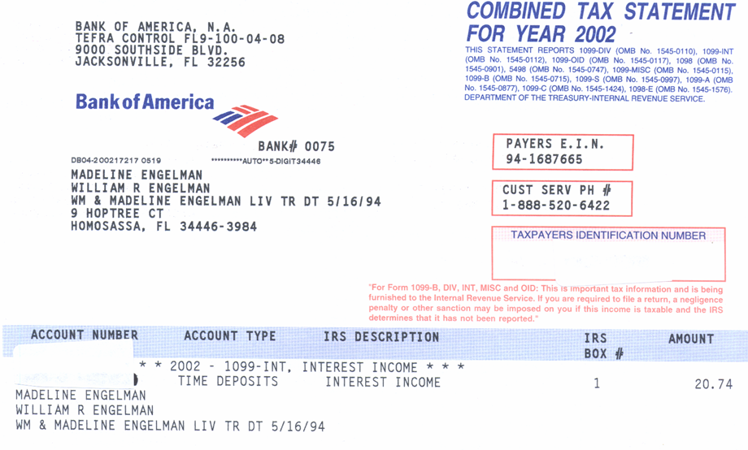
The Bank Statement
2008

Slide 6
Dividends
Main components of 1099-DIV Statement
  Payer
  Ordinary Dividends
  Qualified Dividends (included in Ordinary Dividends)
  Capital Gain Distribution
  Federal Withholding Tax
  Make all entries to Tax Wise “Dividend Statement for Schedule B”

Slide 7
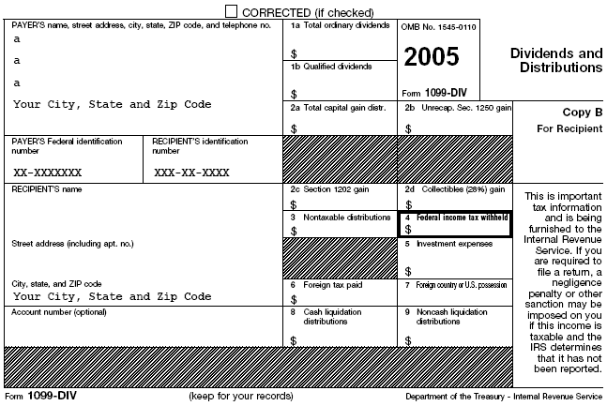
1099-DIV
2008

Slide 8
DIVIDEND STATEMENT – Flows to 1040 Line 9

Slide 9
Interest – NAEOB
Nominee – Interest transferred to, and taxable to, 3rd party
Accrued – Interest accrued for bonds purchased between interest payment dates included in purchase price, not income
Exempt from Federal Tax – Interest on state, county or city bonds (political subdivisions)
OID – Interest received previously included in taxable income (rarely seen)
Bond – Amortized Bond Premium – Adjustment to total OID received
  See IRS Pub 1212 for more detail

Slide 10
Tax Exempt Interest
Generally bonds issued by:
  State/political subdivisions (county or city)
  District of Columbia
  U.S. possessions and political subdivisions
Savings bonds used for education (Form 8815)
All tax exempt interest must be reported on 1040, Line 8b

Slide 11
Tax Free Interest
Interest from all State and Municipal Bonds are exempt from federal taxes
NJ bonds exempt from NJ taxes
Other States’ bonds are NOT exempt in NJ
Interest from U. S. Savings Bonds are exempt from NJ tax

Slide 12
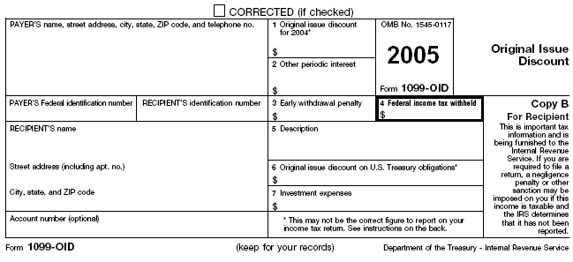
Original Issue Discount Interest (OID)
ENTER
AS ORDINARY
INTEREST
2008

Slide 13
Taxable And Non-Taxable
Interest & Dividends On Federal Returns
Interest
  Input only taxable interest in Amount column
  Input non-taxable interest by entering “E” and insert amount in NAEOB columns
Dividends
  Input only taxable dividends in “Total dividends” column
  Input non-taxable dividends in “Exempt int. div.” column

Slide 14
Taxable And Non-Taxable
Interest And Dividends On Federal vs NJ Returns
Step 1:
  Input taxable and non-taxable amounts on respective worksheets for Federal purposes as noted on previous slide
Step 2:
  If State tax treatment is different than Federal adjust for State by entries in State +/- Column

Slide 15
Interest Statement Examples
Flows to 1040 Line 8a & 8b
1099 - INT
$$$$
1099 - OID
$$$$
SPLIT INCOME – MFJ vs MFS
Flows through Schedule B, Part 1 – if OVER $1,500

Slide 16
DIVIDEND STATEMENT – Flows to 1040 Line 9

Slide 17
Interest & Dividends From Schedule K-1
Schedule K-1 is in scope only if there are just Interest, Dividend, Capital Gains, or Royalties
  Always check with Site Coordinator for all K-1s
  Handling of Capital Gains and Royalties are covered in separate modules
Enter Interest and/or Dividends directly on Schedule B Worksheet, do not prepare or make entries on TW Form K-1
  Include “K-1” in Payer field

Slide 18
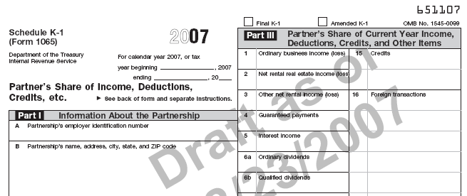
Interest & Dividends From Schedule K-1

